Slide 1
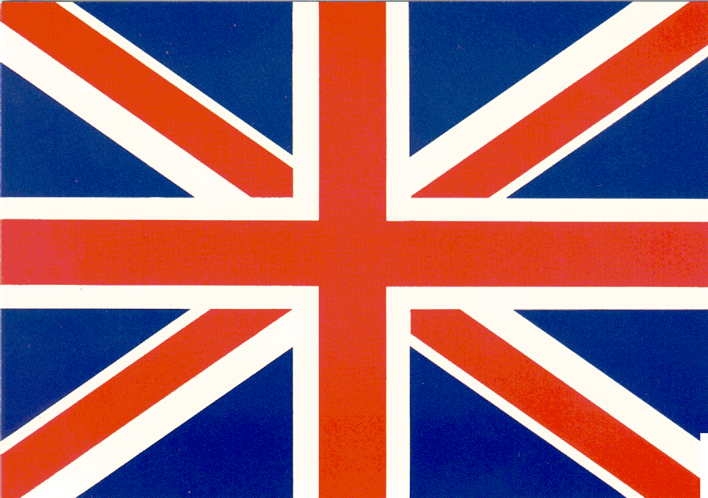

The Development of England and France

Slide 2

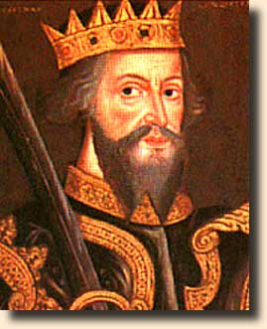
England
In 1066, I, William the Conqueror of Normandy, defeated King Harold of England at the Battle of Hastings. As a result I unified England.
I ROCK!!
No one is a match for my skills… At the battle of Hastings I killed Harold by piercing his eye with an arrow…hahaha
When the Anglo Saxon king Edward died without an heir, his death triggered
a power struggle between Edwards’ brother-in-law Harold and William of Normandy.
Duke William, a Viking, raised an army and won the backing of the Pope. He defeated
Harold at the Battle of Hastings. William later went on to reunite England and complete
the first English census in 1086. He increased the power of the Monarchs and
weakened the feudal relationships, organizing all of England under his rule.
Notes:
William of Normandy was originally from France but conquered England which is why there was so much dispute down the line between England and France about land and right to rule.
William’s rival was Harold Godwinson, who had originally claimed the throne. The battle was called the Battle of Hastings and changed the course of English history.
Declared all of England his personal property
Laid the foundation for central government in England

Slide 3


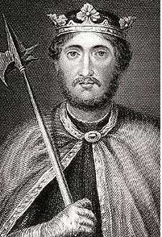
England: William’s Descendants
I am Henry II, I ruled from 1154-1189. I ruled England and owned more than ½ the land in France due to my marriage to Eleanor of Aquitaine. Ok OK… I used her…
I, Henry II, also introduced the use of juries. Thus allowing England’s royal judges form a unified body of law that became known as the common law- became the basis for law in US
I am Richard the Lion Hearted, 1189-1199, my mom was Eleanor of Aquitaine. I ruled England and fought in the 3rd Crusade
Notes:
Two goals of English kings
1) Wanted to hold and add to their French lands
2) They wanted to strengthen their own power over the nobles and church.

Slide 4
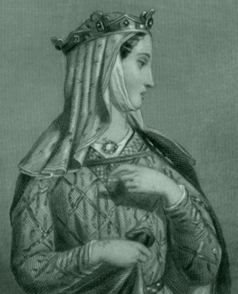
Eleanor of Aquitaine
When I was 15 I married the heir to the French throne, King Louis VII. I went with Louis to the Crusades but we fought (or I may have had an affair) and the marriage ended.
I was heiress to vast lands in France… many men wanted to marry me
In 1152, I married Henry II (11 years younger than me- yeah I robbed the cradle) We had territory in both England and France. We also had 8 children. We also had a stormy marriage so I helped my sons rebel against him. He kept me prisoner in the castle for 15 years.
When Henry II died in 1189, my son Richard the Lion Heart became king and released me. I ruled England in Richard’s absence during the Crusades. After Richard died my youngest son John, gained the throne. I died at 82, one of the most politically involved women in Europe at the time…they even called me Queen.

Slide 5

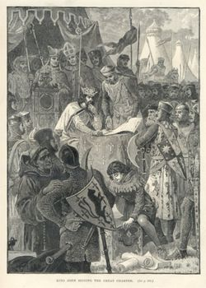
John 1199-1216
Yep, that’s me, King John signing the Magna Carta. I was a cruel and selfish ruler, also son of Eleanor. My people rebelled and forced me to sign the Magna Carta in 1215 at Runnymede
The Magna Carta 1215
No taxation without
Representation
Right to a jury trial
Due process of the law
Limited the monarchy
Notes:
He alienated the Church and threatened to take away town charters guaranteeing self-government.
Raised Taxes to finance wars
His nobles revolted.
The magna carta guaranteed certain basic political rights.

Slide 6
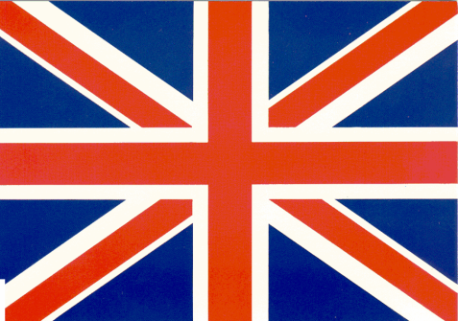
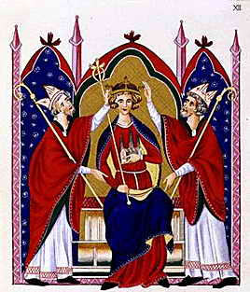
A few more leaders…
I, Henry III, took the crown in 1216 at the age of 9. I ruled for a long and unhappy reign marked by further land losses to France. My reign ended in 1272.

Slide 7

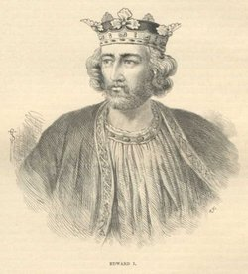
Edward I
I, Edward I, came to the throne in 1272 where I strengthened the administration and the monarchy of England. I raised taxes from the burgesses (merchants) and created the Model Parliament in 1295
Model Parliament
Bicameral government
The House of Commons
And the House of Lords
Provided a check on royal
power
Increased power of the
nobility
Laws passed in Parliament
are applied to entire
Country.

Slide 8

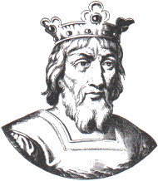
France- Capetian Dynasty
I am Hugh Capet. Yes, I was a relatively weak king chosen by French nobles. But I began to strengthen my power starting with Paris.
Yes, my son and grandson were also weak, but the Capetian dynasty was just getting started. The Capetian dynasty will gradually expand to control most of France.

Slide 9

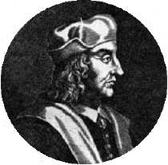
Philip II Augustus
I came to power at the age of 15. I was determined to be a better king than my father. I, Phillip II, further strengthened the monarchy through the use of bailiffs (royal officials who collected taxes)

Slide 10

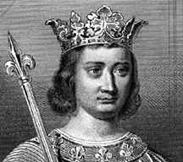
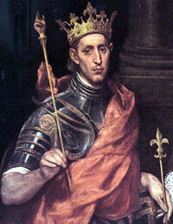
More French….
I, Louis IX was deemed a Saint by the Church. I came to the thrown as a pious, popular, and just leader. I also created the Parliament of Paris, which acts as a Supreme Court.
Philip IV created the Estates General because of a dispute with the Pope’s right to control affairs in HIS kingdom
First Estate- clergy
Second Estate – Nobility
Third Estate – Bourgeoisie
Not as powerful as Parliament

